Slide 1
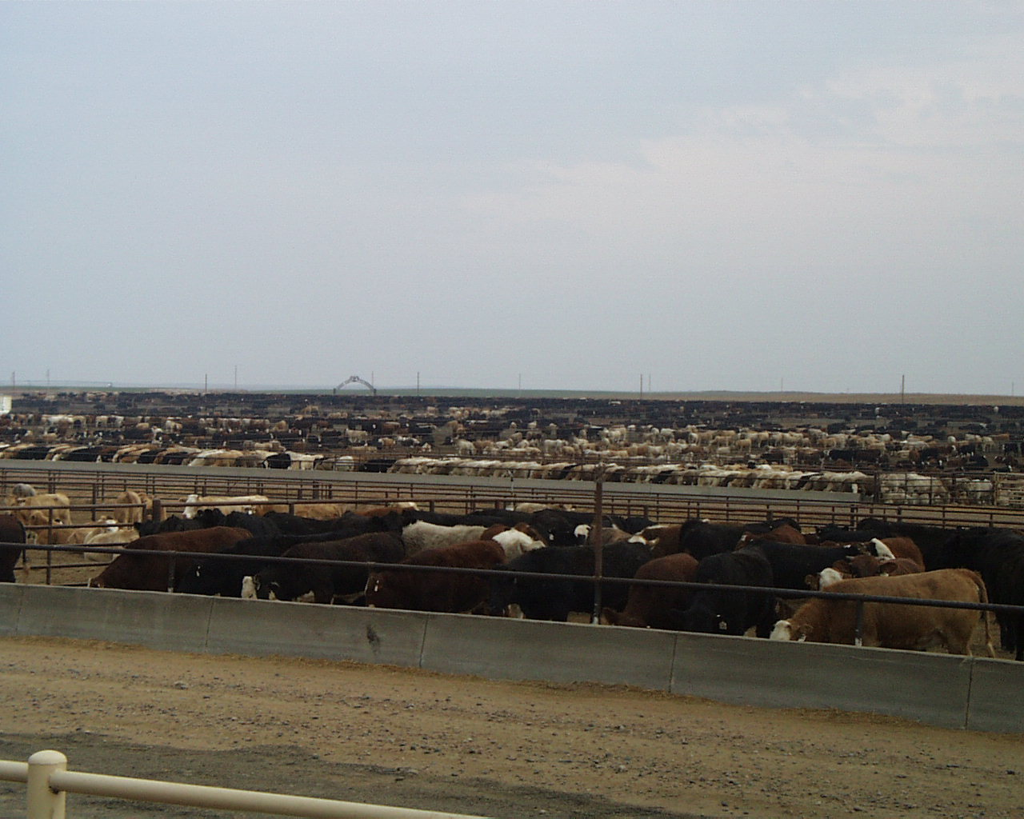
Advanced Beef Cattle Health and Well-being training
A.J. Tarpoff, DVM, MS
Kansas State University

Slide 2
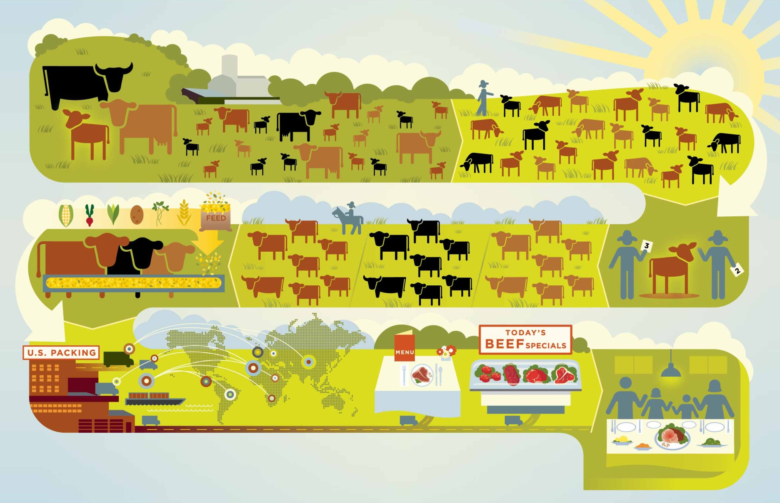
Beef Lifecycle
ONE BEEF CONCEPT
Cow-Calf
Weaning
Stocker/Backgrounder
Feedyard
Retail /Foodservice
Harvest/Fabrication
Notes:
This is an example of the primary way that beef goes from pasture to plate and the entire community of people that it takes to raise beef today. As you can see, it’s a long and thoughtful process that involves many people from pasture to plate. The goal of everyone in the beef community is to make the best use of the resources we have to sustainably raise the highest quality beef.
[Point out which part of the beef community you represent and talk about your role and personal commitment in working with other members of the community to raise high quality beef for the people in your audience, as well as your own dinner table.]
Family farmers and ranchers depend on other members of the beef community to deliver beef from their pasture to your plate. In order to make the best use of the resources we/they have, such as grass pasture, we/they need other members of the community to grow grain and hay to feed cattle when the grass isn’t growing or a place to move cattle after weaning time at about one year, so we/they can raise another calf crop (cows have a nine month gestation period similar to humans and typically produce one calf per year).
For example, we/they might sell calves to a stock/backgrounder who has wheat or corn pasture or to a feedyard in an area where they grow abundant supplies of grain. Of course, we/they also need someone to slaughter, process and deliver the beef we raise to the consumer.

Slide 3
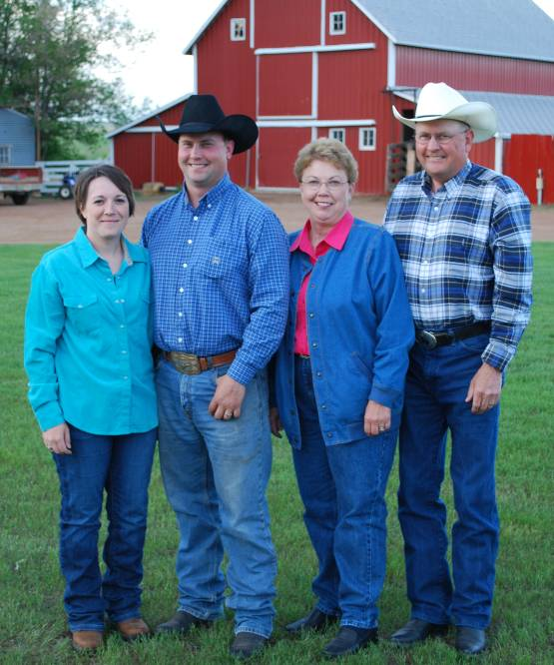
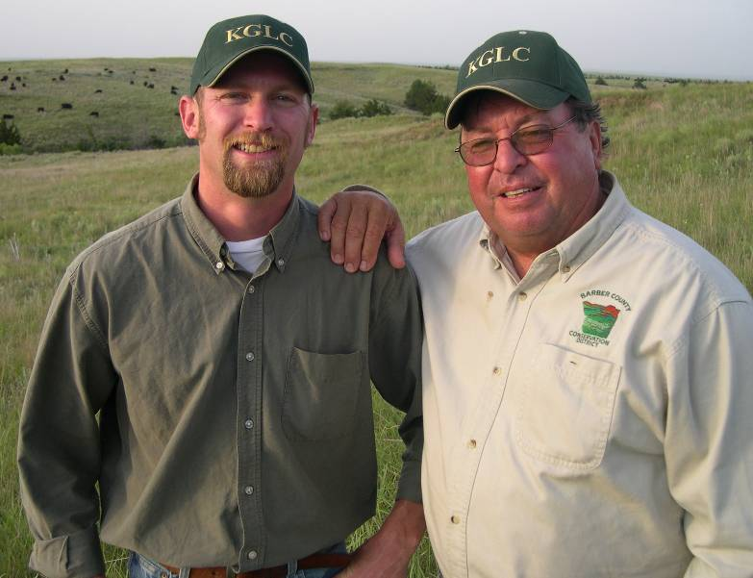
What industry doesn’t change?
97% of U.S. cattle farms & ranches are family owned & operated
Notes:
That’s right, beef is raised by families, not factories. Family farmers and ranchers make up the foundation of the beef community. Today, there are approximately one million U.S. cattle farmers and ranchers making daily decisions on how to raise beef. You may be surprised to learn that:
97 percent of beef farms or ranches are family-owned,
54 percent of these farms and ranches have been in the same family for three generations or more, and
64 percent of cattle farmers and ranchers say that they hope to continue the tradition by passing down their farm or ranch to their children.
[Talk about your family history, how you got involved in raising beef, etc.]
Raising cattle is a family tradition! So, if this is true, why do we hear so much about factory farms these days? Well, times have changed and most people are disconnected from their agricultural roots. Less than 2 percent of the population lives on a farm and raises their own food, or food for them and their neighbors. Sure, there are still many opportunities to buy beef directly from a farmer or rancher, like farmers’ markets and even over the internet. But the vast majority of consumers buy their beef at the grocery store or their favorite restaurant and therefore don’t know how we raise food or have a chance to get to know the people, like me, who raise food.
Source: Profile of U.S. Cattlemen, Aspen Media & Market Research, July 2010. This data was collected through telephone interviews with a statistically representative list of 791 farmers and ranchers with different types of operations nationwide to create a profile of today’s cattlemen and their values.

Slide 4
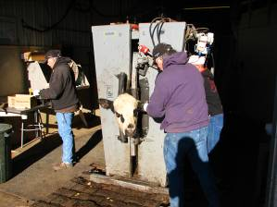
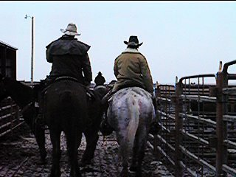
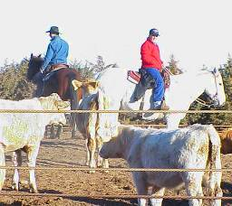
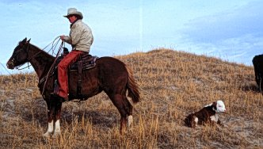
Nobody cares more about cattle than the people in the beef industry.

Slide 5
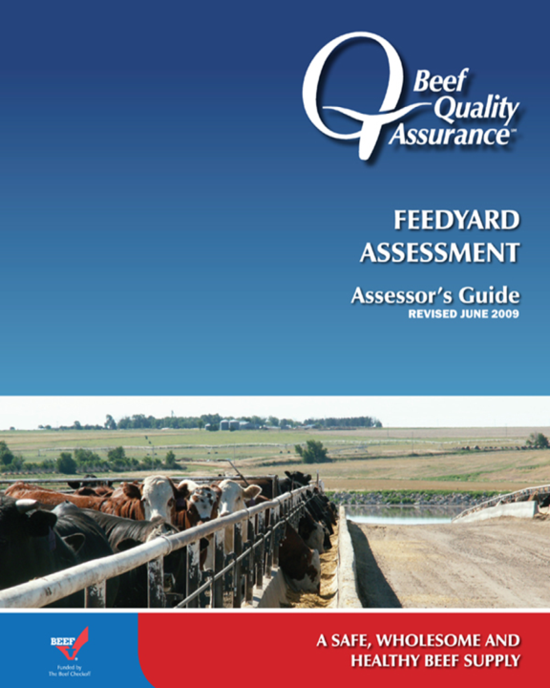
Freedom from Thirst or Hunger
Freedom from Discomfort
Freedom from Pain, Injury and Disease
Freedom to Express Normal Behavior
Freedom from Fear or Distress
Notes:
In order to answer those questions, the Five Freedoms were used to create

Slide 6
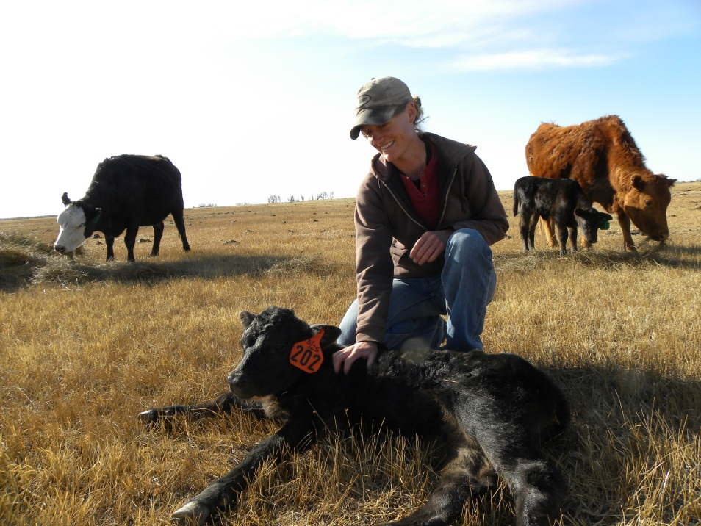
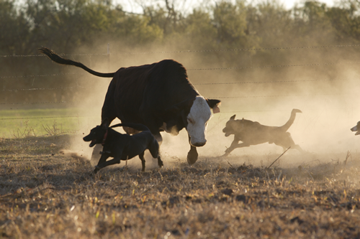
Creating the culture verses audit

Slide 7
NCBA BQA Animal Welfare Assessment tool for feedyards
Freedom from abuse or neglect
Inappropriate use of driving aids
Hitting or beating an animal
Improper movement of non-ambulatory animal
Neglect of an animal that needs care or shelter
Starvation, downed animal, suffocation
Emergency Action Plan in place

Slide 8
Freedom from thirst or hunger
Random selection of cattle pens
Inspect water sources
Inspect feed bunks
Protocol for medicated feeds
Pre-harvest food safety
Production of feed delivery records
Feed quality
Consultation
Avoidance of mycotoxins and chemical residues

Slide 9
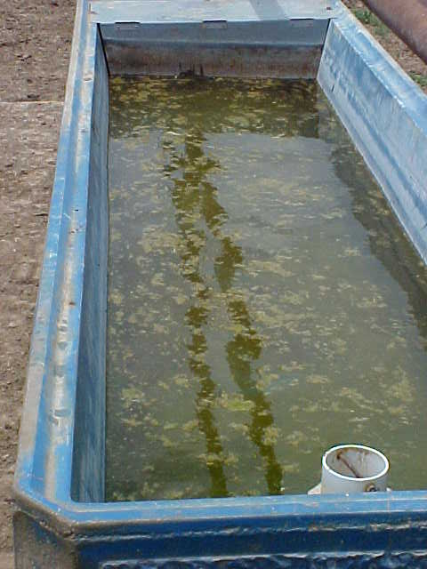
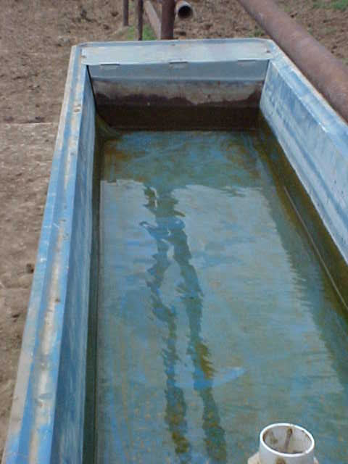

Slide 11
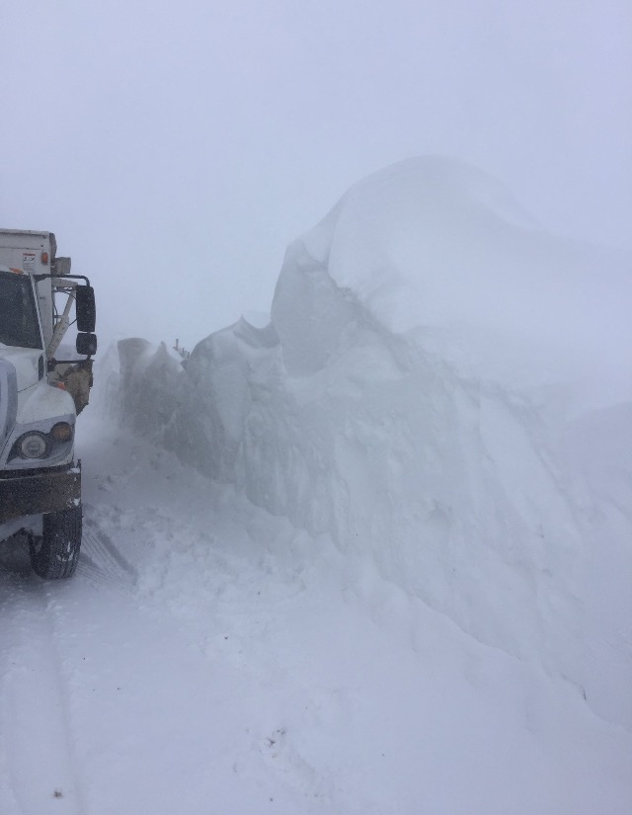

Slide 12
Freedom from discomfort
Random selection of pens across yard
Mud score
Protocols for general pen maintenance
Protocol includes plan for adverse rain and snow events
Inspection of….
Processing area
Loading/unloading area
Hospital area

Slide 13
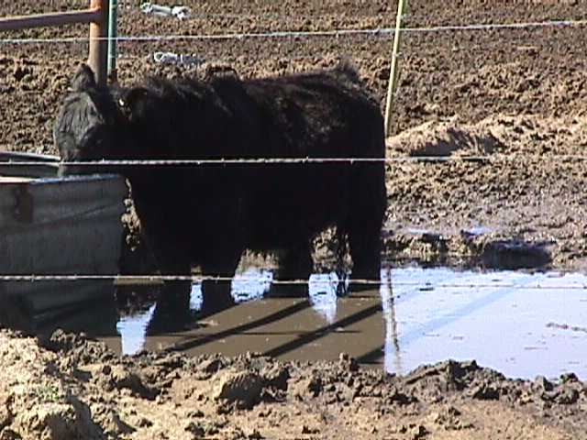
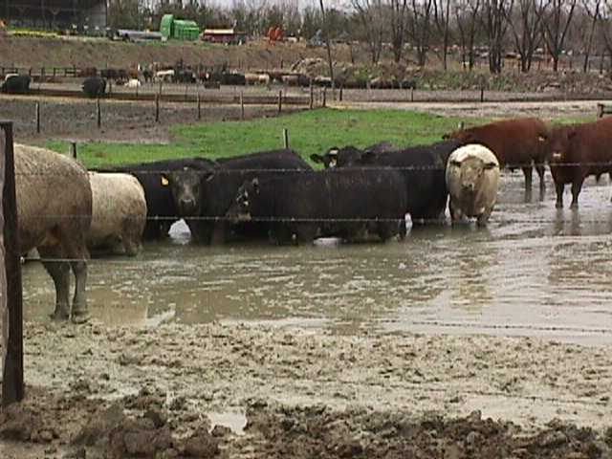
Mud happens: Got a plan?
Winter time mud ADG losses
No mud 0%
Dewclaw deep 7%
Shin deep 14%
Below hock 21%
Hock deep 28%
Belly deep 35%
Receiving pens!!!!!
1991, Beef Feeder, UNL

Slide 14
Progressive Cattleman

Slide 15
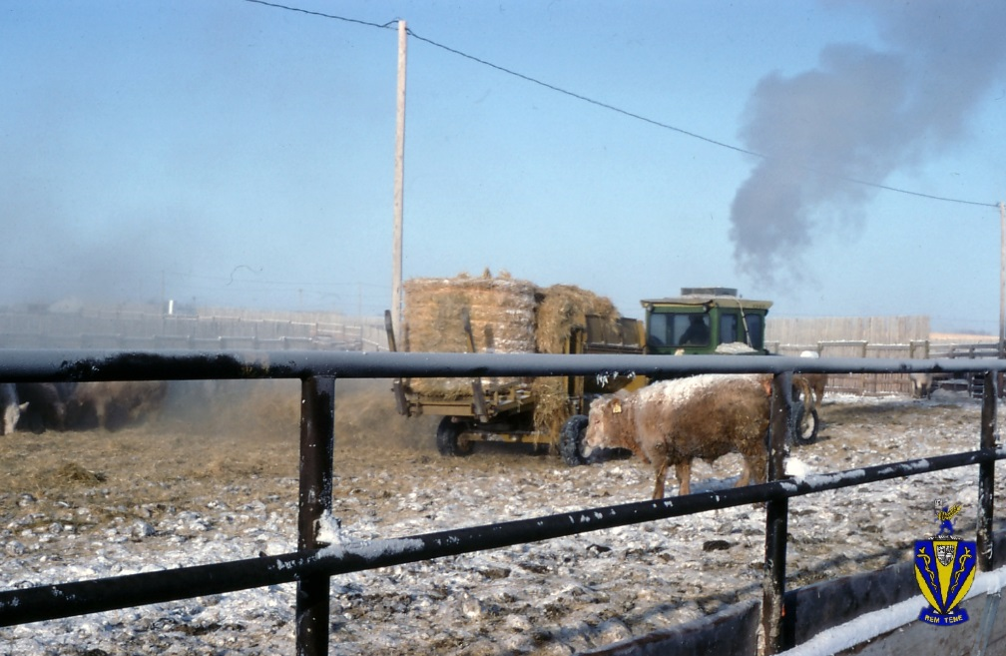
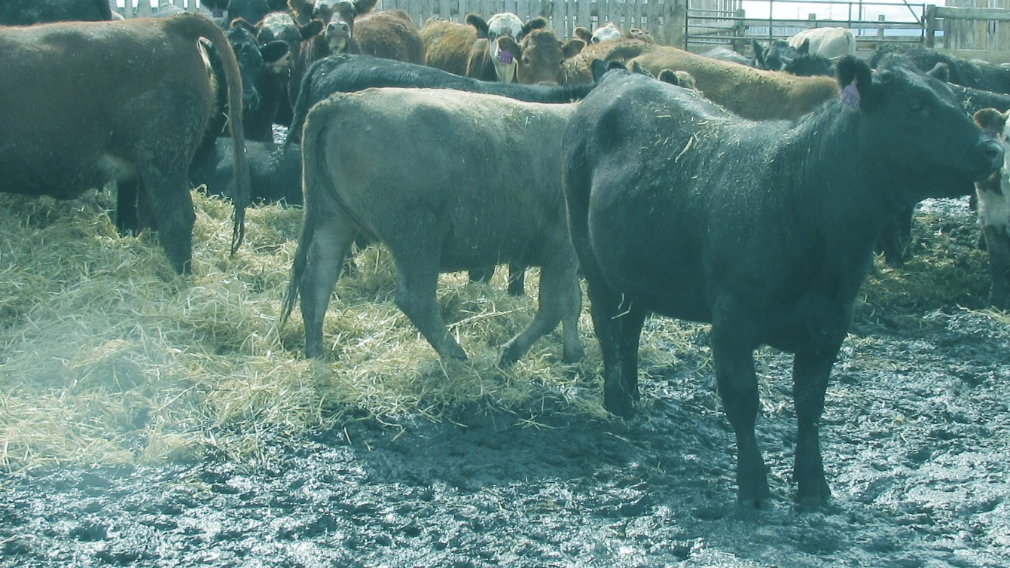
Good bedding pack composts, providing heat for cattle comfort
Bedding also improves pen
conditions & minimizes
manure tag on the hide
Notes:
Bedding during the winter months is also very important. This bedding provides a warm comfortable area for cattle to rest upon. Secondary effects of proper bedding are improved pen conditions, and minimizing the tag on the hides of cattle. Bedding material may come from a number of sources. Typically straw or corn stalks are used.

Slide 16
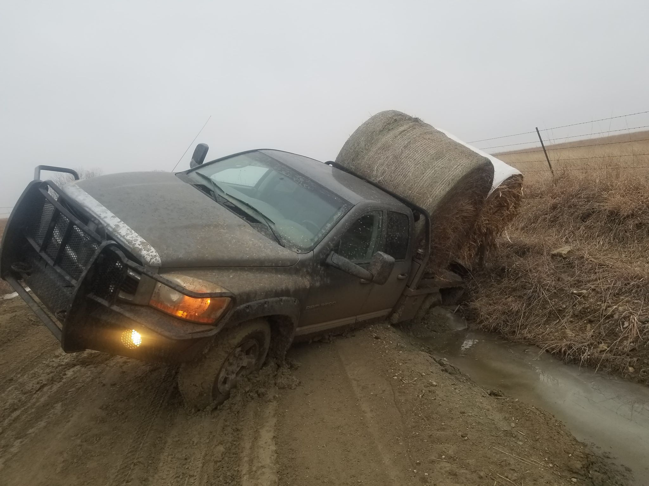

Slide 17
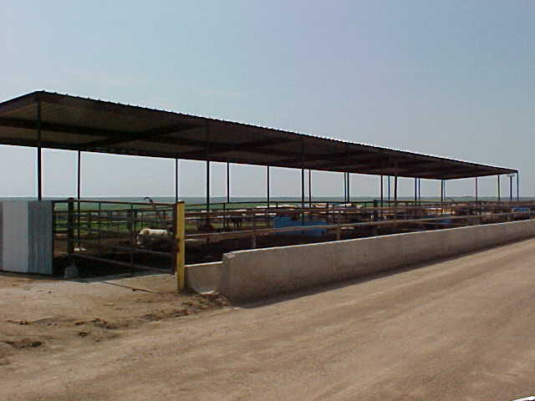
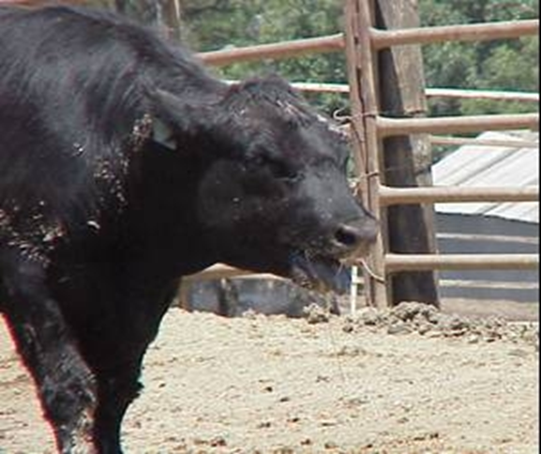
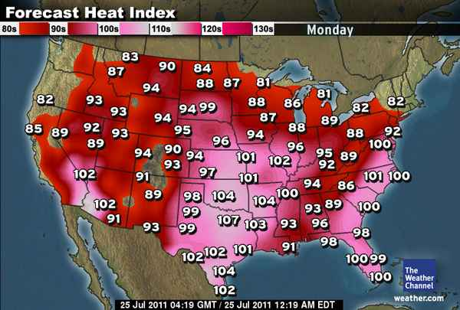
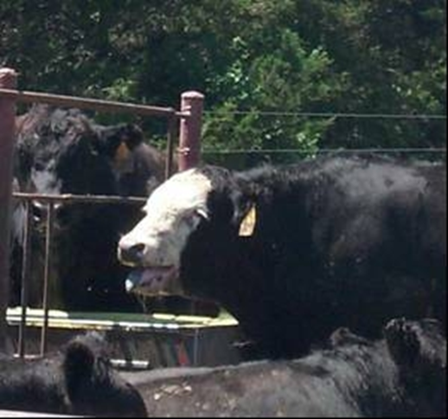
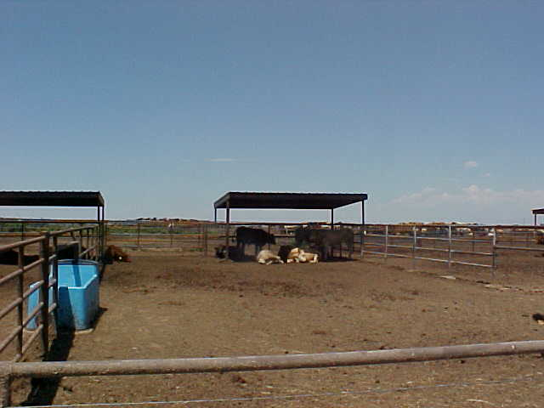
www.ars.usda.gov

Slide 18
Freedom from fear or distress
On-site audit of animal handling
Driving aid use
Cattle falling upon release from chute
Cattle stumbling or tripping exiting the chute
Cattle vocalizing before procedure
Cattle running or jumping exiting the chute
Cattle miscaught in chute
Review of facilities where animals could slip
Documentation of employee training for animal handling and caring for non-ambulatory animals

Slide 21
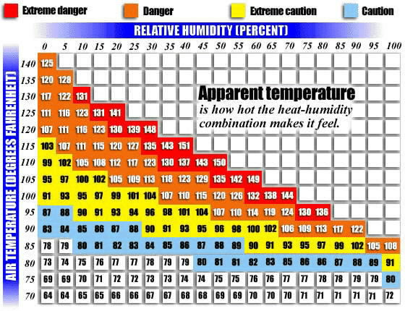

Slide 22
Processing Facilities/cattle handling
Must have proper facilities
NCBA BQA handling audits
10% hot shot
2% falling down exiting chute
25% running out of the chute
4% vocalization

Slide 23
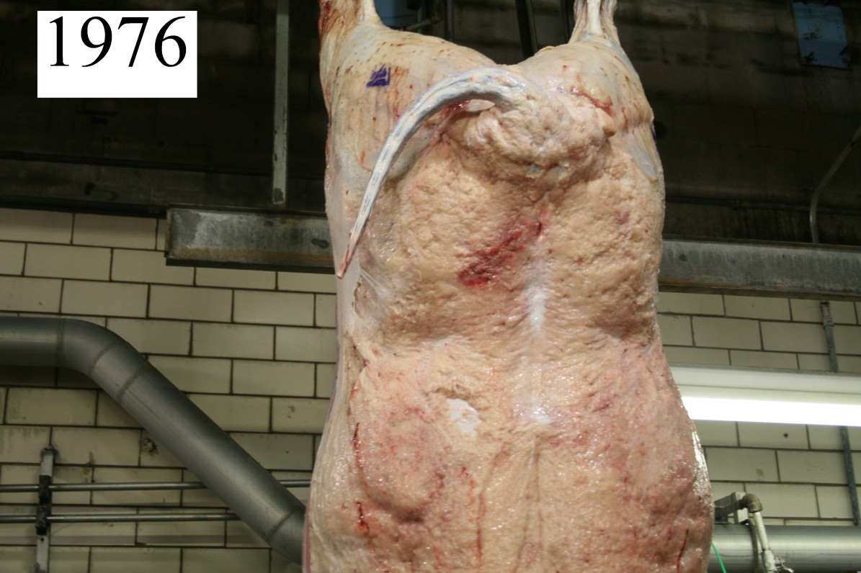
No Hot Shots????
Notes:
Dr. Robyn Warner’s (Australia) recent works shows repeatedly shocking 15 min b4 slaughter results in decreased tenderness. But would this induce the same if not more stress than the proper use of a hot shot in addition to chronic pain and trim?

Slide 24
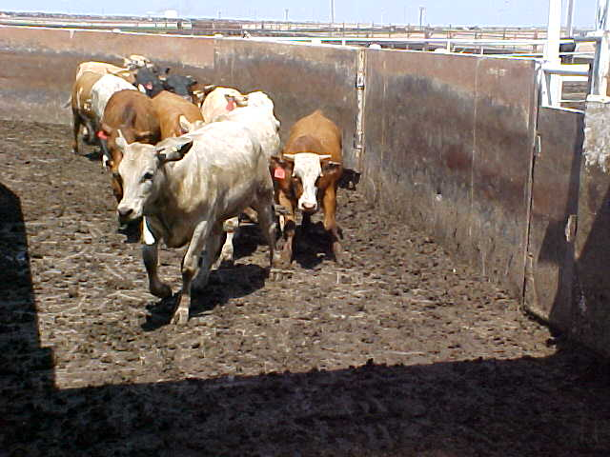

Slide 25
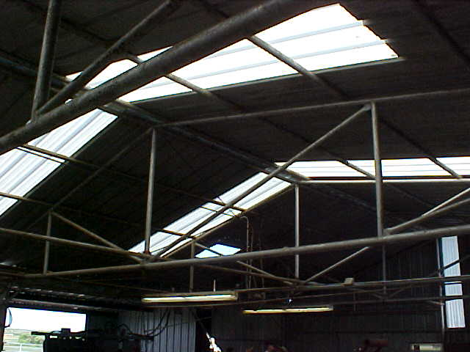

Slide 28
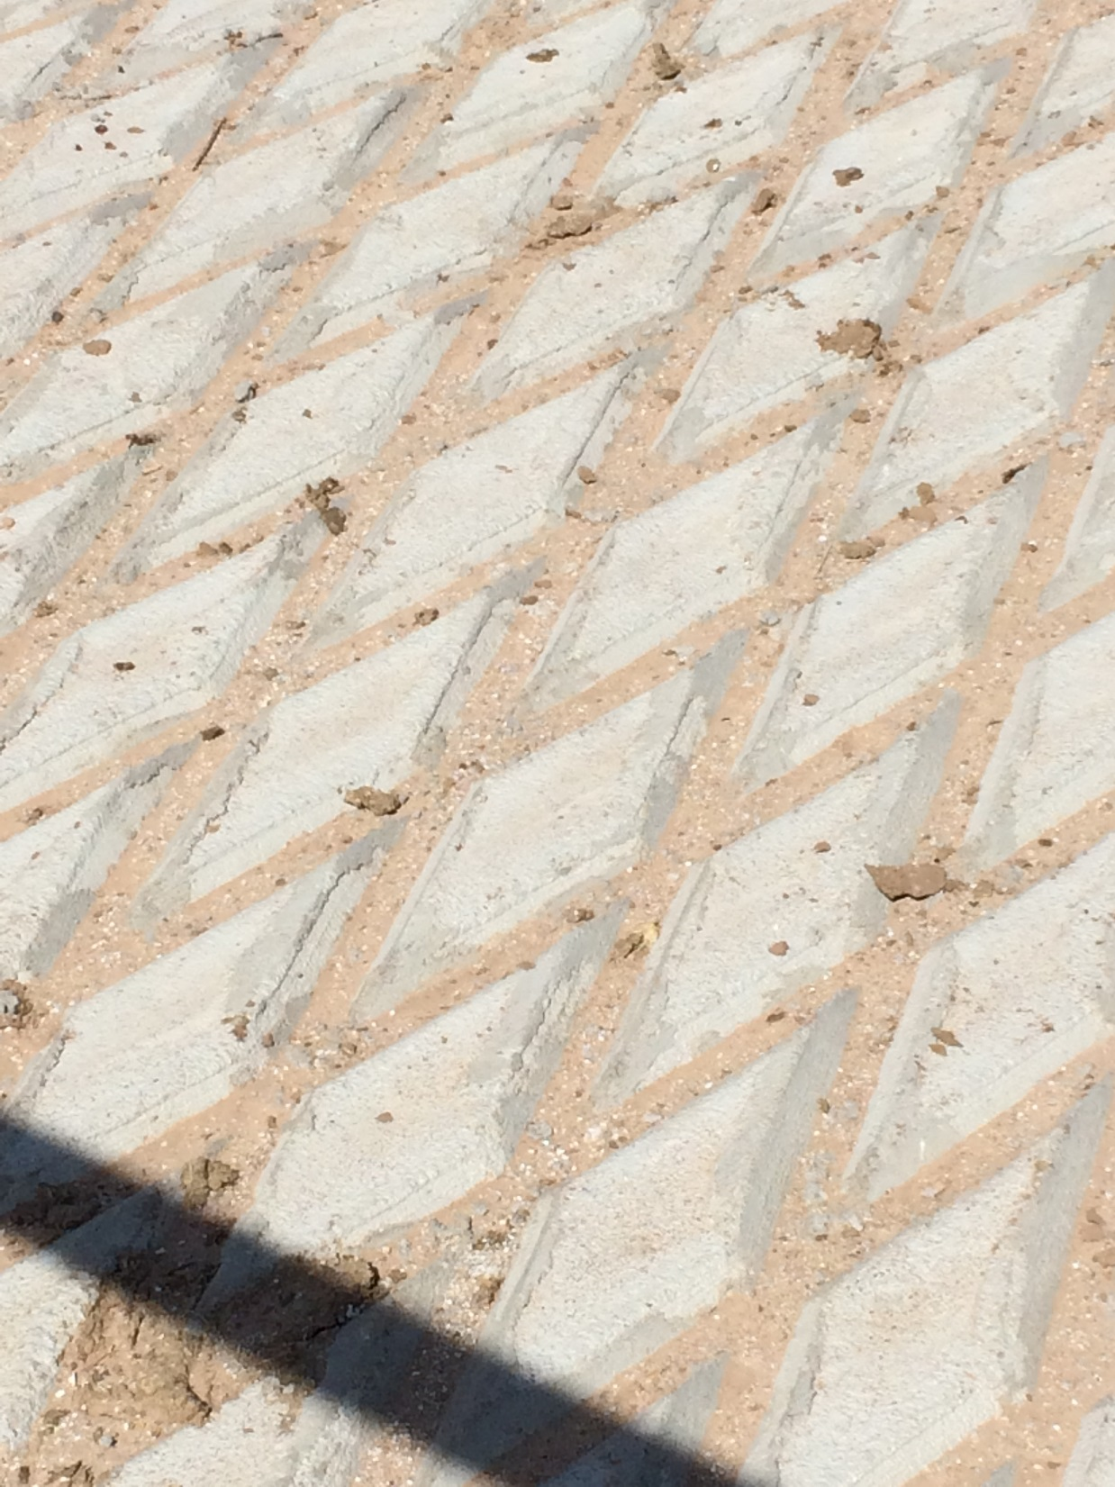

Slide 29
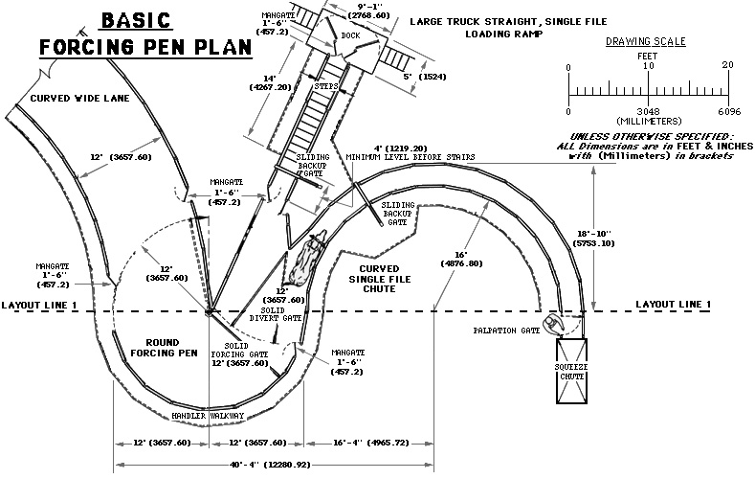
Tub system design by Temple Grandin

Slide 30
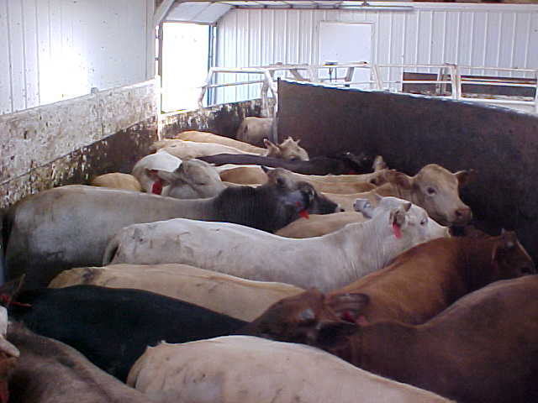

Slide 31
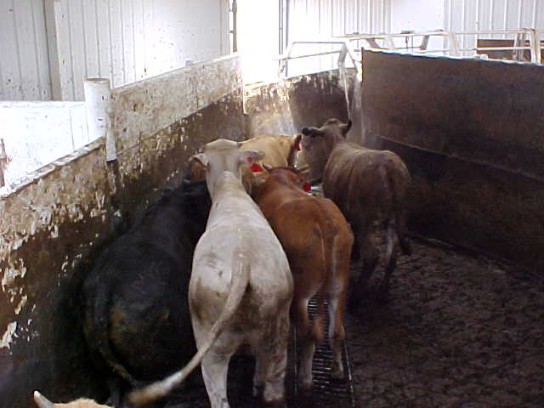

Slide 32
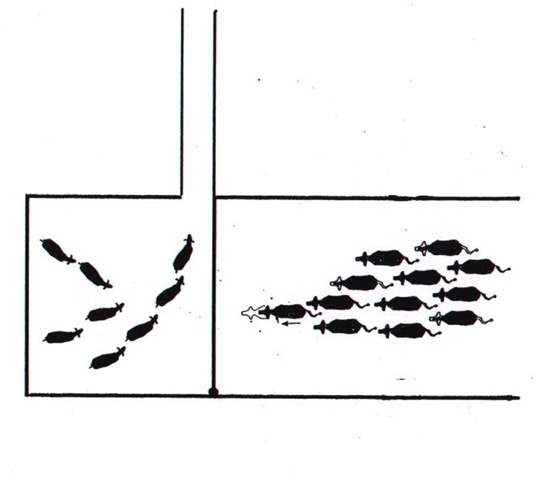

Slide 34
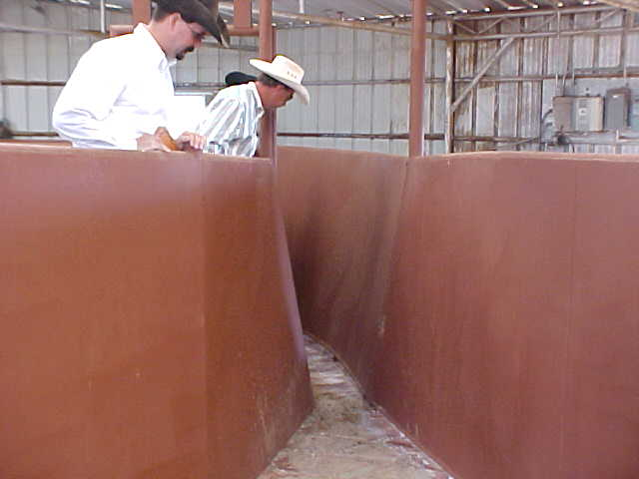

Slide 35
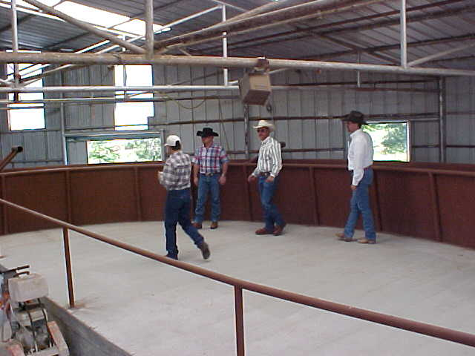

Slide 36
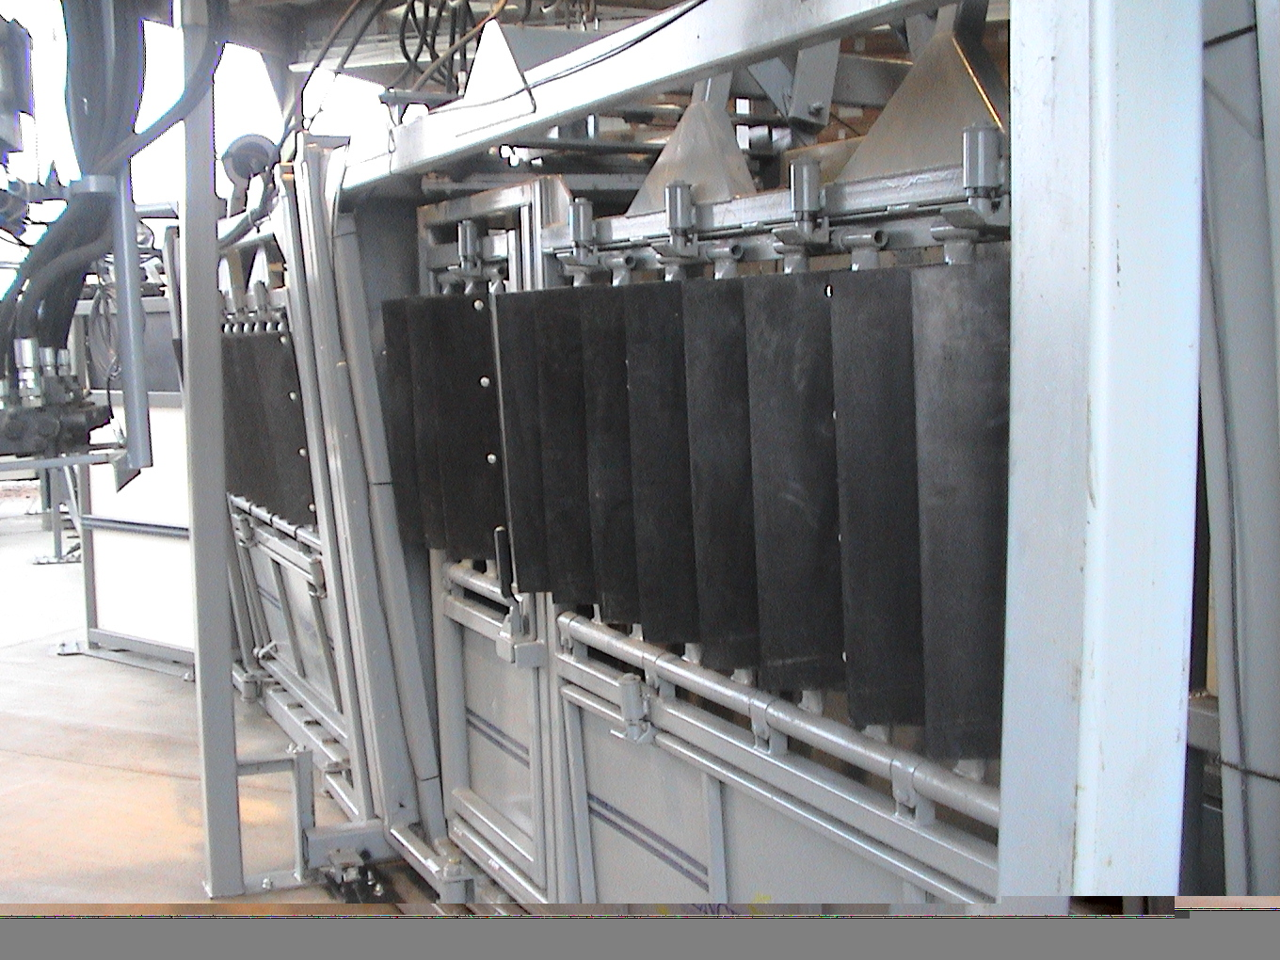

Slide 37
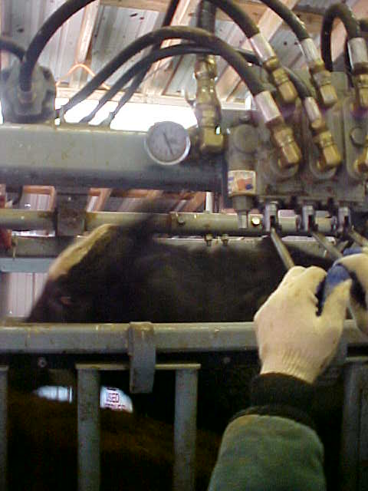
Pressure gauge
If pressure
gauge doesn’t
go back to
zero, we need
to replace it.

Slide 38
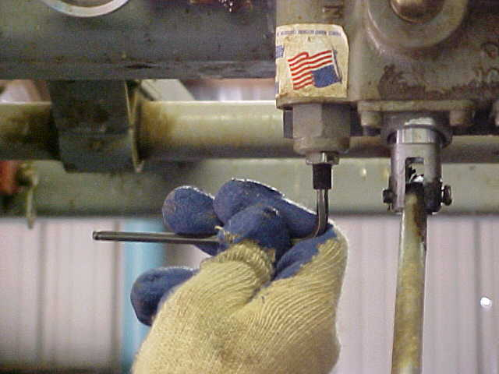
Rotate left to lessen pressure
3/16 inch

Slide 40
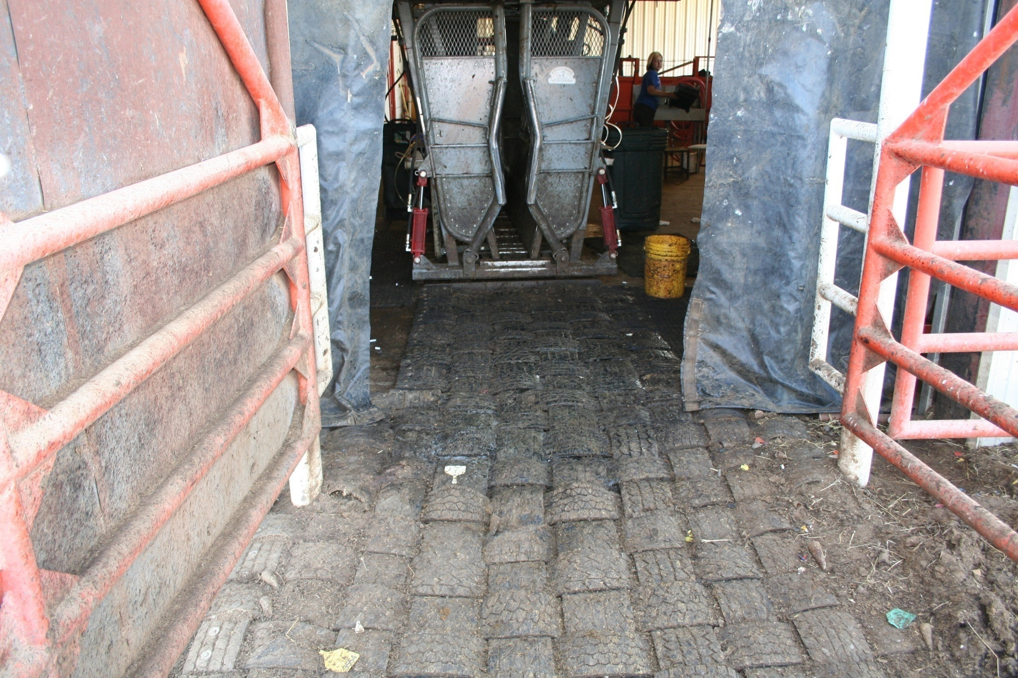

Slide 42
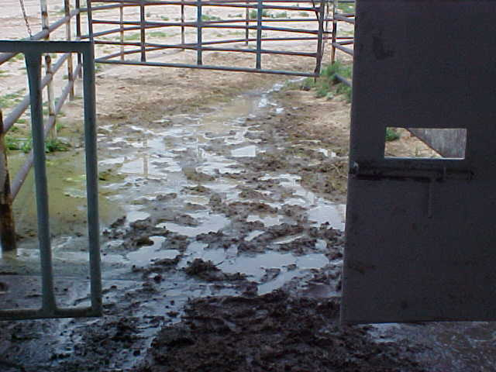

Slide 43
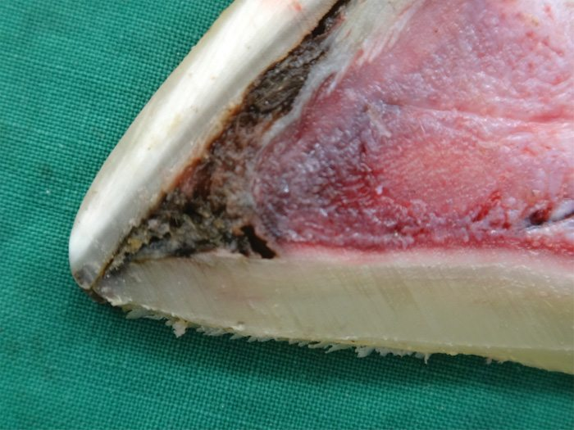
Toe tip necrosis/toe abcesses

Slide 44
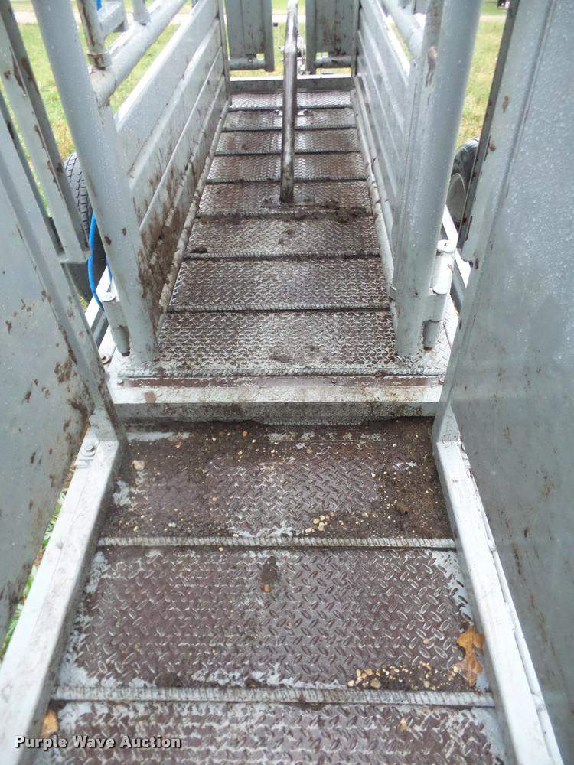

Slide 45
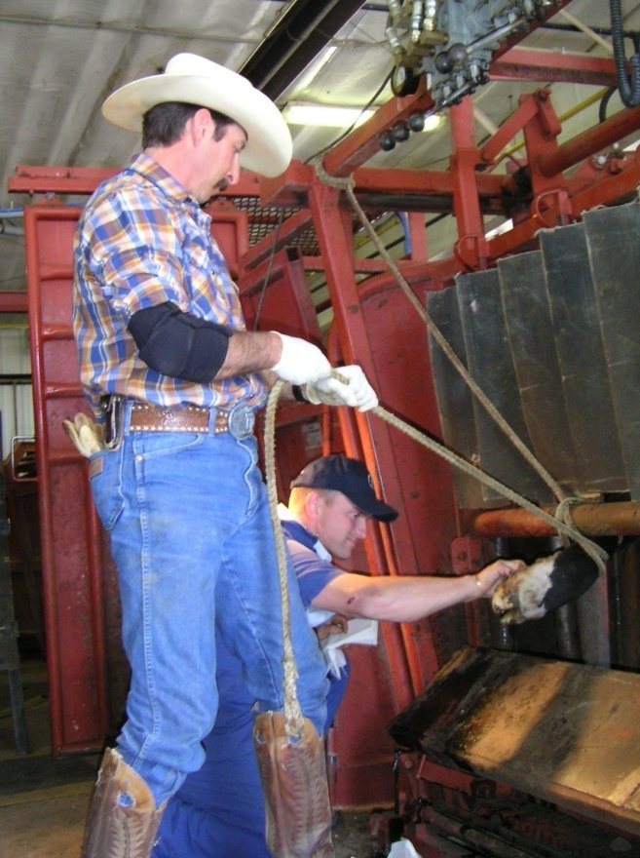
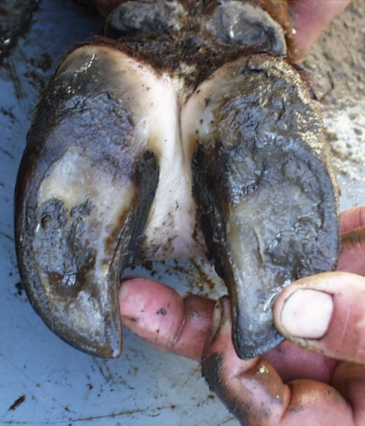
IDENTIFYING THE PROBLEM
Pick Up The Foot
Wash It
Examine To Determine Cause of Lameness

Slide 46
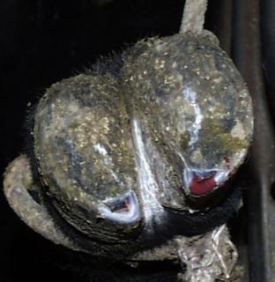
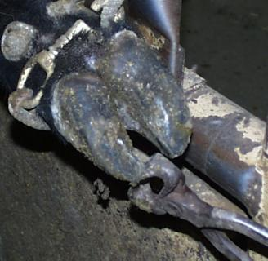
TOE ABSCESS
TREATMENT
Tip Toe To Drain Abscess And Relieve Pressure
DO NOT TRIM ENOUGH TO CAUSE BLEEDING
May require extended therapy
Too Deep
Correct

Slide 47
Cattle Handling Observations

Slide 48
Freedom from pain, injury or disease
Inspection of facilities for areas in which injuries could occur
Documentation of employee training for acceptable methods (when applicable)
Castration
Dehorning
Downed animal care
Euthanasia
Calvers

Slide 49
Documented BMPs & SOPs

Slide 50
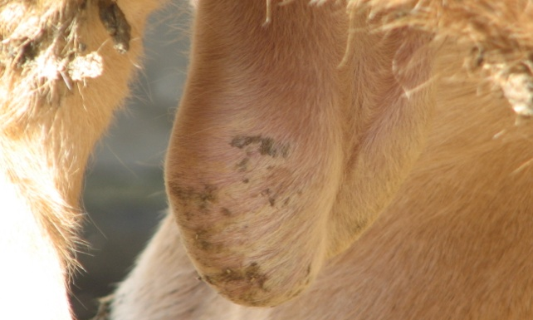
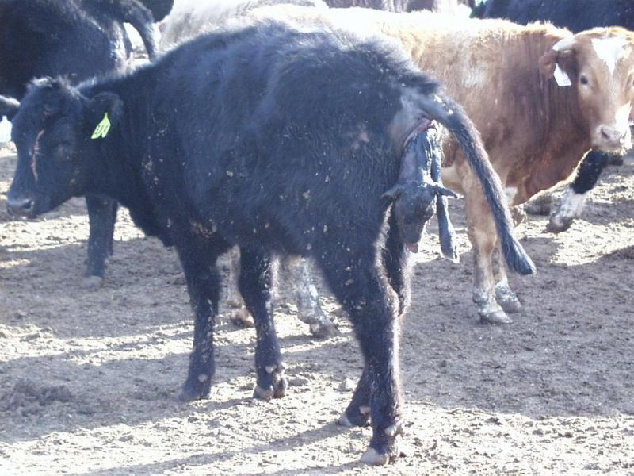
Castration, dehorning and pregnancy: timing is everything.

Slide 51
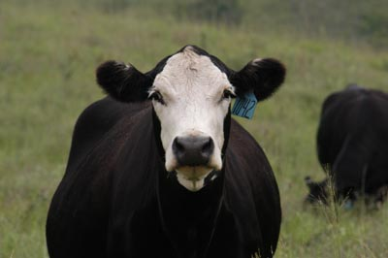
Responsible care for downed Cattle

Slide 52
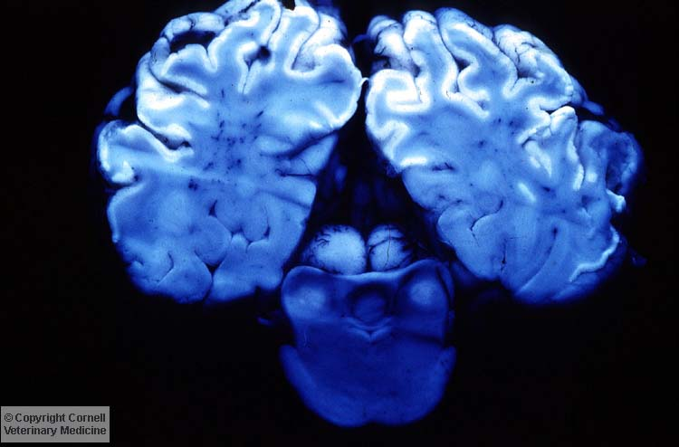
Causes of downed animals
Listeria
Polio
Lead
Tetanus
Nervous coccidiosis
Histophilus somnus

Slide 53
Care of Downer Cattle

Slide 54
Moving Downer Cattle
Unacceptable Transportation Methods:
Dragging
Lifting with chains
Acceptable Transportation Methods:
Sled
Low-boy trailer
Bucket of a loader

Slide 55
Nonambulatory/Injured Animals
slednsling.com
Notes:
This picture is an example of a sled which the animal is rolled onto the mat, and moved to a safe place to treat. Notice a rope halter is tied from the animals’ head to a rear leg. This is to prevent trauma to the animal’s head during this process. When handling nonambulatory animals animal and handler safety is important to keep in mind.

Slide 56
Prognosis
Alert downer verses moribund
Animal husbandry
Shelter, hay and water
24 to 36 hours to show improvement
Roll every 6 to 12 hours to prevent compartmentalization
Humane euthanasia

Slide 57
Euthanasia Gunshot

Slide 58
Euthanasia
Notes:
Safety is a priority when euthanizing feedlot animals. It is a good idea to have an easily assessable escape route when dealing with mobile sick/injured animals. Keeping the animal calm will help with proper euthanasia location.

Slide 59
Animal Selection
Severely injured and unable to recover e.g. broken leg, broken jaw
Chronic, severe, or debilitating pain and distress from chronic disease
Show continuous weight loss or emaciation
BCS < 2
Notes:
It is important that it is clearly defined when an animal must be promptly euthanized. Animals that have no prospect of improvement must be euthanized. Examples include:
Severely injured or non-ambulatory animals unable to to recover or cannot be slaughtered.
May include
Broken leg
Broken back
Large wounds with a grim prognosis (into chest or abdominal cavity)
Chronic, severe, or debilitating pain from chronic disease. The animals have failed to respond to treatment and convalescent protocols.
May include
Polyarthritis
Necrotic arthritis (clubfoot)
Chronic bovine respiratory disease
Show continuous weight loss or emaciation
Animals displaying a body condition score of less than 2 These animals typically have severe illness. They are very thin, all the ribs can be seen easily, prominent skeleton (vertebrae, hips, pin bones)
Non ambulatory and nonresponsive for more than 24 hours
After 24 hours the chances of the animal recovering is slim. Unless ordered treatment by the feedlot vet, they should be euthanized.

Slide 60
Goals
Performed in a timely manner
Method of euthanasia should minimize
Pain
Distress
Anxiety prior to loss of consciousness
Methods should be:
Rapid
Performed correctly
Notes:
The overall goal of euthanasia is to do it efficiently. It should be performed in a timely manner when the decision has been made that it is needed. The method chosen for euthanasia should minimize pain, distress, and anxiety prior to loss of consciousness. The method chosen must also be rapid and performed correctly.

Slide 61
Euthanasia Anatomical Landmarks

Slide 63
CT scan of the mid-sagital view of a representative skull from the .22 solid point treatment group

Slide 64
CT scan of the mid-sagital view of a representative skull from the .22 hollow point treatment group.

Slide 65
CT scan of the mid-sagital view of a representative skull from the 9mm pistol treatment group.

Slide 66
CT scan of the mid-sagital view of a representative skull from the 12 gauge 1 oz slug treatment group.

Slide 67
Euthanasia Captive Bolt
Dangerous in field situations or may not gain results you want

Slide 68
Confirmation of Unconsciousness/Death
Notes:
Confirmation of death is very critical regardless of type of euthanasia. It is common to see limb movements and an agonal non-repetative breath. The following can be used to confirm death:
Lack of corneal reflex (a conscious animal will blink when the eyeball is touched)
Large dilated pupil, Also the eye returns to the center of the socket
Lack of respiration (movement of chest in a rhythmic pattern indicates respiration)
Lack of heart beat (use of a stethoscope behind the elbow)

Slide 69
Unacceptable methods of euthanasia
Manually applied blunt trauma to the head
Injection of any chemical substance
Injection of air into a vein
Electrocution as with 120 or 220 volt electrical cord

Slide 70
Disposal of mortalities

Slide 71
Withdrawals
Set by the FDA (part of approval process)
It is illegal to sell treated cattle that have not met the product withdrawal time
Not just antibiotics
Vaccines
Dewormers/pesticides
Most animal health products

Slide 72
Tolerance Levels
Levels deemed safe by the FDA
Measured in PPM or PPB
Some products have Zero Tolerance
No detectable amount allowed
Monitored at processing facilities
Violations lead to condemned carcasses, regulatory action, fines, herd quarantine, or criminal prosecution

Slide 73
Drug Residues
Failure to observe withdrawal times
Injectable products
Oral products
Feed additives
Pesticides

Slide 74
Causes for Drug Residues
Off label usage
**FARAD guidance by veterinarian under VCPR
Too high of volume
Improper placement (SQ vs. IM)
Compromised tissue
Compromised health
Kidney/liver function
Reduced Clearance

Slide 75
Carcasses with antibiotic residue by production class in 2010
Beef cows = 0.11%
Dairy cows = 0.15%
Market Steers = 0.06%
Market Heifers = 0.00%
Market Hogs = 0.13%
Poultry all classes = 0.00%
Source: FSIS, 2012

Slide 76
Injection Site Management
Injection Triangle
A - Ahead of point of shoulder
B – Above the vertebrae
C - Below Nuchal Ligament
C
A
B

Slide 77
Proper Injection Route
Subcutaneous (SC)
Intramuscular (IM)
IM
SC
Skin
Subcutaneous tissue
Muscle

Slide 78
Appropriate Needle Size
16-18 gauge ½ to ¾ inch needles for SQ
16-18 gauge 1 to1-1/2 inch needles for IM

Slide 79
Injection Spacing
4 inches apart
Hand width apart
Side-by-Side

Slide 80
Injection Volume
Read product label
Maximum – 10 mL / injection site

Slide 81
Sanitation
Disinfect needles when injecting non-MLV products
Change needles with MLV vaccines
Never re-enter bottle with used needle
Changing needles
USDA recommends single use needles (3/1/18) press release bulletin
BLV, BVD, Anaplaz

Slide 82
Injection Site Lesions
Don’t inject into top butt

Slide 83
Incidence of Blemishes at Harvest
Product | Branding IM Injections | Weaning IM Injections
2 mL Clostridial | 72.5% | 46.3%
5 mL Clostridial | 92.7% | 79.5%
Vitamin A & D | 5.3% | 10.0%
LA Oxytetracycline | 51.2% | 92.3%
Colorado State University

Slide 84
Eye of Round Injection Lesions found in Beef Purchased for Roast Beef Sandwiches
Lesion Damage (continued)
Notes:
Lesion Damage (continued)
Eye of Round injection lesions found in beef purchased for roast beef sandwiches.

Slide 85
Quality Control of Animal Health Products
Proper storage temperature
Often 35°-45°F
Storage temp on Label
If Delivered, ensure proper temperature upon arrival
Always transport with ice packs (Do not allow direct contact)

Slide 86
Storage Matters
Store under proper conditions
When purchased
Prior to use
Chuteside

Slide 87
Refrigerators
University of Nevada
20 ranches, 4 feed stores
25% of the refrigerators failed to maintain vaccines in the safe zone (35°-45°F)
University of Arkansas
180 refrigerators tested
45 were only at proper temp range 5% of the time
76% were unacceptable for storing animal health products
23% <5yrs, 34% 6-10 yrs, 22% 11-15 yrs, and 21% >15 yrs old

Slide 88
Vaccines
Protect from sunlight
Protect from freezing
Do not mix different vaccines together
Mix up only what you can use in 1 hour
Keep vaccines thoroughly mixed

Slide 89
Vaccination Process
Mark syringes for different vaccines
Use products from original containers
Never re-enter a bottle with a used needle
Keep equipment clean
DO NOT use disinfectant with MLVs
Can also damage Killed

Slide 90
“As much as cattle are worth, I’m going to do all I can to help them live”

Slide 91
Why precondition or background?
Castration
Pregnancy
Vaccinations
Bunk and water tank broke
Cattle flow
Facilities
RCHS

Slide 92
“People who work together will win, whether it be against complex football defenses or the problems of a modern society”– Vince Lombardi

